Slide 1

Extended Business Logic – CW..
March, 2021

Slide 2
Summary
Overall Status
Steps
Tools
Roles
Current
354
10
9
Connectivity service is not yet released
Tools​
S/4 oData Service Provisioning​
S/4 User Management​
S/4 Role Maintenance​
S/4 Business event enablement
Cockpit​
Visual studio code
Cloud Connector​
Event Mesh application
Kyma
Github (CI/CD)
Roles​
S/4 Developer​
CP Developer​
S/4 Security Role Admin​
Network admin
CP Admin​
Event Mesh manage role
Serverless function role​
CI/CD Admin​
Kyma developer Role
Backend: S4H OnPrem 2020
Kyma runtime
Cloud Connector version: 2.12.1.1

Slide 3






Solution Diagram
Business Partner Validation
HTTP
S4 Events
HANA Cloud
Event Mesh
SAP S/4 HANA On Premise
Business Partners
Event Mesh
OData
S4 REST APIs
Image processor
[Functions]
Connectivity/
Destination
Identity Provider

Slide 4
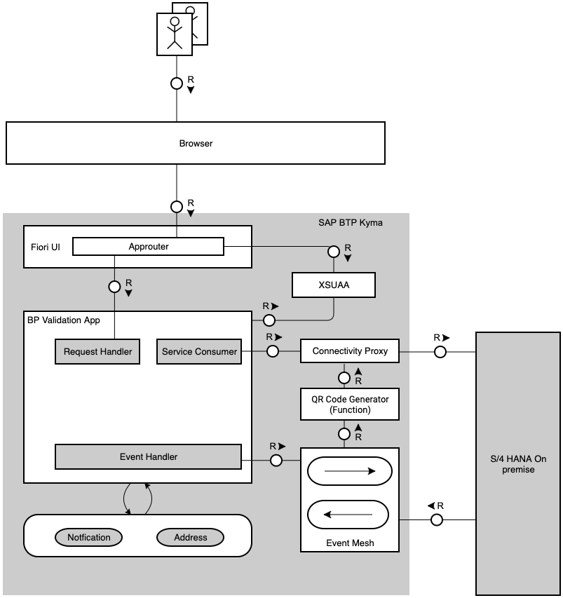
TAM

Slide 5
Business Scenario used for validation
Combine data and business processes
As an employee of Business Partner Validation Firm iCredible, which is a third party vendor of ACME Corporation, John would like to get notifications when ever new Business Partners are added in the S/4 HANA backend system of ACME Corporation. John would then be able to review the Business Partner Details in his extension app. He would then proceed to visit the Business Partner’s registered office and do some background verification. John would then proceed to update the verification details in his extension app and proceed to approve it. Once the business partner is approved in extension app, it gets activated in the S/4 HANA system of ACME Corporation and also a QR code containing the verified address is attached to business partner in S/4 HANA on-premise system.
Pain Points
Business Partner Data available only in S/4 HANA system
Third party vendor needs access to S/4HANA system to do his work
QR code needs to generated and upload to S/4 HANA system
Benefits
Custom extension application that works independently from S/4 HANA
Changes in S/4 communicated via events in real time to extension application.
QR Code generation on demand (serverless environment)
Vendor personnel needs access to only custom app

Slide 6
Status Quo - Extend Business process Scenario- Kyma Runtime
Step | Sub-Scenario | Steps | Tools | Role | Comments
1 | Enable Kyma | 27 | 1 | 1
2 | System Setup | 66 | 3 | 3 | Additional packages like kubectl, heml, chocolatey are required at this step.
3 | Git Setup
4 | Configure Cloud connector and destination | 64 | 1 | 1
5 | Setup CF | 20 | 1 | 1
6 | Create HDI Container | 36 | 1 | 1
7 | Create services using Deployment file | 2 | 1 | 1
8 | Configure S4 system with queue subscription | 17 | 2 | 1
9 | Create Queue and Queue Subscription | 21 | 1 | 3
10 | Configure S4 System with OData services | 75
11 | Configure helm repository | 6 | 1 | 1
12 | Build image for the application | 19 | 1 | 1
13 | Deploy the application using Helm charts | 3 | 1 | 1
14 | Create Serverless application (git credentials setup) | 18 | 1 | 1

Slide 7
Feedback/Issues
Si No | Ticket | Description | Component | Status | Comments
1. | https://jtrack.wdf.sap.corp/browse/NGPBUG-154301 | Issue in XSUAA | XSUAA | In Process

